Slide 1





IBM SKILLSBUILD INTERNSHIP FOR EMERGING TECHNOLOGIES APR-MAY 2023
MENTAL FITNESS TRACKER
PROJECT
Presented by: SURINENI RANJITH KUMAR
E-mail id : ranjithranji1903@gmail.com
College Name : Methodist College of Engineering of Technology
State : Telangana
Internship Domine : Artificial intillegence
AICTE ID : STU6436e334de2ed1681318708
Internship start and end dates : 6Week from 12/06/23 - 24/07/23

Slide 2




PROBLEM STATEMENT
1 .Propose a data visualization strategy that effectively communicates mental fitness tracking insights to users, making the information easily understandable and actionable. What visual representations would be most impactful?
2. Design a machine learning algorithm to analyze and classify user-generated text data (e.g., social media posts, journal entries) to identify potential indicators of stress, anxiety, or depression. How would you handle data privacy concerns in this process?
3. Implement an AI-powered chatbot that engages with users, asking targeted questions to assess their mental health and offer appropriate resources or support. How would you design the conversation flow to be empathetic and non-intrusive?

Slide 3


AGENDA OF MENTAL FITNESS TRACKER
Depending on the exact features and tools that the tracker offers, the agenda for a mental fitness tracker can change. But some typical items that might be on an agenda for a mental fitness tracker are as follows:
Setup: This could involve making a user profile, deciding on mental health objectives, and choosing the metrics to monitor (such as stress, mood, sleep,and exercise)
Data logging: This process entails recording details about everyday activities, including how much you slept, what you ate, how much you exercised, and how you felt emotionally.
Data analysis: The tracker may examine the data you've submitted and offer perceptions into patterns or trends in your mental health, such as detecting stress or anxiety causes.
Goal-tracking: The tracker may help you establish and follow objectives for bettering your mental health, such as increasing your physical activity or incorporating mindfulness into your daily life.
Tools and resources: The tracker may include tools and resources to improve mental health, including stress-reduction exercises, guided meditations, and cognitive behavioural therapy activities. Reminders and notifications: The tracker could send you notifications or reminders to assist you stay on track with your mental health objectives and to motivate you to enter data frequently
Progress evaluation: The tracker may offer periodic progress reports or summaries to assist you in evaluating your mental health over time and identifying areas that want improvement
The goal of a mental fitness tracker is to assist users manage their mental health by giving them the tools and resources necessary for monitoring, analysing, and managing their mental health.

Slide 4

Overview
Goals: The goal of the mental fitness tracker for tracking and monitoring many elements of their mental health, meloding mood sleep, ercise food, medication use, and stress levels. The tracker's users can establish and monitor objectives for being des health access tools and resources for managing mental health and well-being and uncover patterns and trends in their mental Sealble over time. Features. The features of the mental fitness tracker can range from data logging to data analysis goal tracking to tools and resources, remindersand notifications, and progress reviews to give users a tool.
Technology: A mix of technologies, such as used in the creation of mobile apps, websites, data analytics, and machine learning, will probably used to create the mental fitness tracker. Depending on the tracker's features and the project's objectives, several technologies will be employed
Timing: Depending on the project's scale, the size of the development team, and the resources available, the timing for the mental fitness trackerproject will vary. The project might be completed in a number of phases, each of which would concentrate on a particle set of characteristics or

Slide 5


WHO ARE THE END USERS...?
People of all ages who want to improve their mental health and well-being might be the final consumers of a mental fitness tracker. People who have been diagnosed with mental health issues like depression, anxiety, bipolar disorder, or post-traumatic stress disorder (PTSD), as well as those who are motivated to preserve excellent mental health, can fall under this category. A mental fitness tracker may be advantageous for the following particular groups of people:
People who are struggling with mental illness A mental fitness tracker can be used by people who have been disposed with mental health disorders to keep tabs on their symptoms, pinpoint the causes of those symptoms, and create coping mechanisms to deal with those symptoms
Athletes and fitness devotees. Athletes and fitness devotees can use a mental fitness tracker to track their levels of physical activity, observe their sleep patterns, and establish objectives for enhancing their general well-being
Students and professionals: By keeping track of their mood, sleep, and exercise routines, students and professionals can reduce stress and increase productivity.
Carers and professionals in mental health Carers and professionals in mental health can use a mental fitness tracker to monitor the mental health of their patients or clients and offer tailored assistance and interventions as necessary.
In general, a mental fitness tracker can be used by anyone who wants to monitor and enhance their mental health and well-being, regardless of age or background.

Slide 6
YOUR SOLUTION AND ITS VALUE PROPOSITION
I can provide some broad benefits that users of such a tracker might receive:
A mental fitness tracker can help users uncover patterns and trends in their mental health over time by monitoring several compons of all like mood, sleep, exercise, and stress levels. After learning this information, one can adjust their lifestyle for the better and create coping mecha to deal with stre, axity, and other mental health issues.
Personalised insights and recommendations: Based on the information users enter into the tracker, a mental fitness tracker can offer personalised it and suggestions, For instance, if a user's mood is typically low in the morning, the tracker can advise them to try getting more sleep or starting an spirits. in the morning to lift their
defining and monitoring objectives: A mental fitness tracker can assist users in defining and monitoring goals for bettering their male mach as increasing exercise or engaging in mindfulness exercises. Users can maintain motivation and make modifications as necessary to attain their intended outcomes by tracking progms towards these targets.
Access to mental health resources: A lot of mental fitness trackers give users access to a range of mental health tools, mncluding guided meditation CBT exes, and stress reduction methods. These tools can aid users in creating good coping mechanisms and enhancing their general mental health
Convenience and simplicity: A mental fitness tracker may be a simple and straightforward tool for keeping tabs on metal wellness Users can what information about their mental health into a straightforward mobile app or web-based platform and instantly obtain personalised insights and recommendations
A mental fitness tracker can, in general, provide its users with a variety of advantages, such as enhanced mental health, tailored insights and goal-setting and tracking, access to mental health resources, convenience, and ease of use

Slide 7






CUSTOMIZE THE PROJECT
▷ Here are some points on how one could customize the mental fitness tracker.
1. User Interface and Design: Customize the user interface to make it visually appealing. intuitive, and user-friendly. Consider different color schemes, layouts, and interactive elements to create a pleasant and engaging experience.
2. Goal Setting and Tracking: Allow users to set personalized mental fitness goals, such as daily mindfulness practice, weekly stress reduction targets, or monthly cognitive training objectives. Implement tracking mechanisms that display progress over time, motivating users to stay on track.
3. Activity Selection: Offer a wide range of mental fitness activities to suit different preferences and needs. This could include mindfulness exercises, meditation sessions, cognitive puzzles, journaling prompts, or even mood tracking features.
4. Personalized Recommendations: Utilize machine learning algorithms to analyze user activity and preferences, then provide tailored recommendations for mental fitness exercises that are likely to resonate with each individual user.
5. Reminder System: Include a customizable reminder system to prompt users to engage with mental fitness activities regularly. Users should be able to set their own schedule for receiving reminders via push notifications or emails.

Slide 8
MODELLING
Designing a mental fitness tracker project involves various aspects to consider. Below are some essential points to keep in mind during the modelling phase:
1. User Interface and Experience (UI/UX): Focus on creating an intuitive and user-friendly interface Ensure than the design comic and appealing to of all ages backgrounds
2. Features and Functionality: Define the core features of the mental fitness tracker, such as mood tracking, stress level string, meditation gades, galing
3. Data Collection and Privacy: Determine the data points to be collected, such as mood ratings, activities, and habits. Address user pracy cons and comply with data regulations.
4. Machine Learning Integration: Explore incorporating machine learning algorithms to provide personalized insights and recommendations band
5. Goal Setting and Reminders: Allow users to set mental health goals and receive reminders to practice mindfulness exercises or engaging actres
6. Notification System: Implement an optional notification system that alerts users of their mental fitness progress and encourages consistent usage
7. Social Interaction: Consider adding social features, like support groups or the option to share achievements, to create a sense of commity among users
8. Data Visualization: Create clear and visually appealing graphs or charts to help users understand their mental fitness trends over time 9. Third party Integration: Explore integrating with other health apps or wearable devices to gather more comprehensive data, like sleep pattes or physical activity
10. Gamification Elements: Introduce gamification aspects like rewards, badges, or challenges to make the app engaging and motivate users to contingit
11. Testing and Feedback: Conduct extensive usability testing and gather user feedback to refine the app and make necessary improvements
12. Accessibility: Ensure the app is accessible to users with disabilities, such as providing text-to-speech features or accommodating colorblind das 13. Scalability and Performance: Design the application architecture to handle a potentially large user base and ensure smooth performace under hecy age
14. Security: Implement robust security measures to protect user data and prevent unauthorized access or data breaches
15. Marketing and Monetization: Develop a clear marketing strategy and decide on the app's monetization model such as in-app purchases, subscription pins, or advertent
16. Continuous Improvement: Plan for regular updates and enhancements to keep the app relevant and competitive in the mental finess market

Slide 9

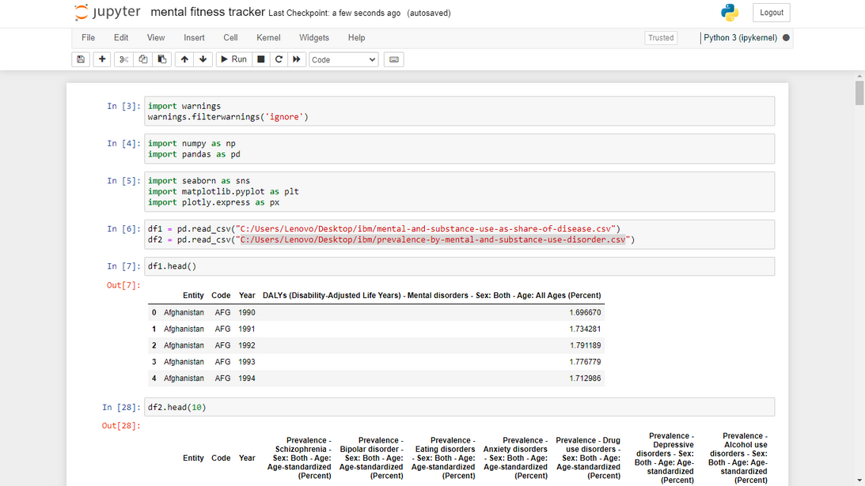
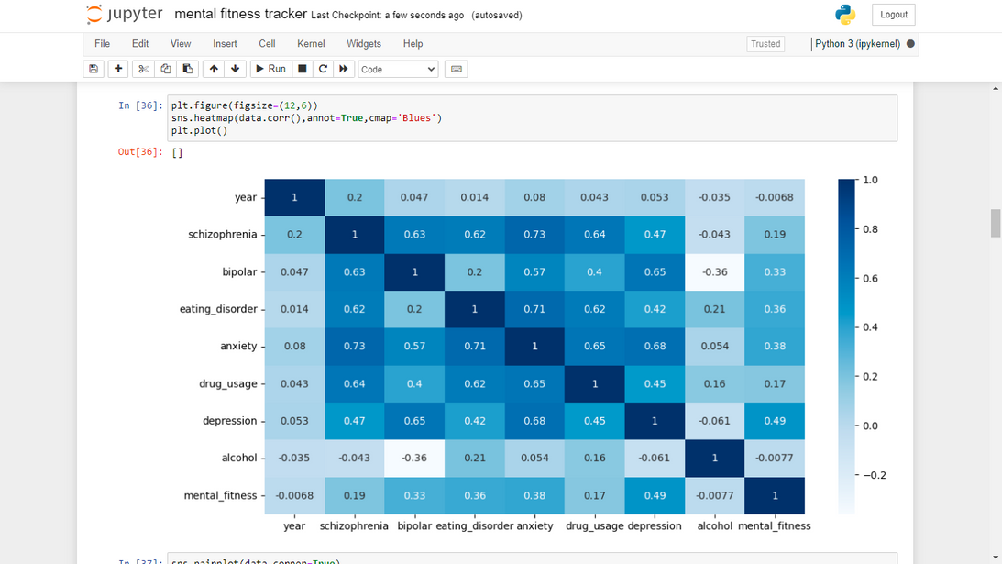
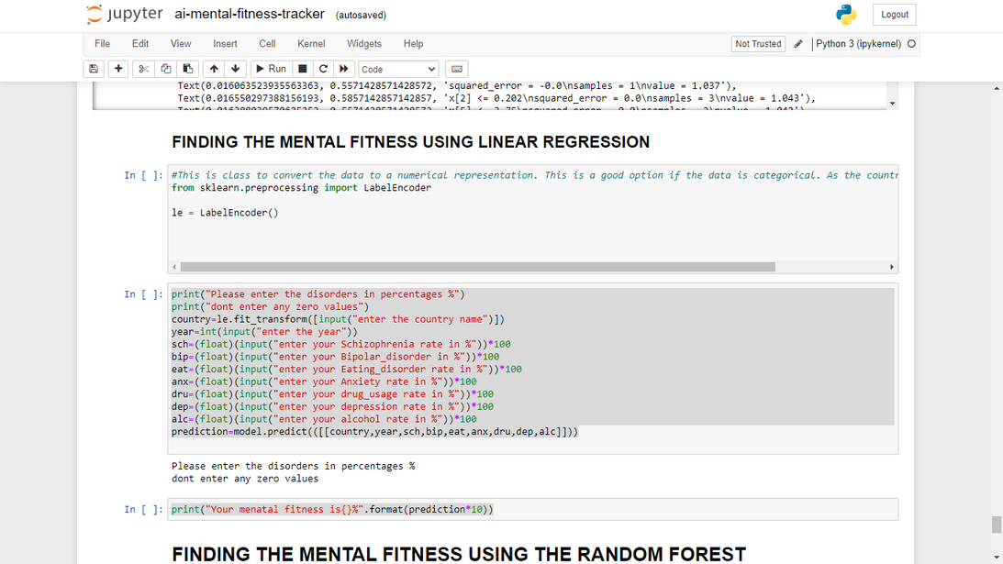
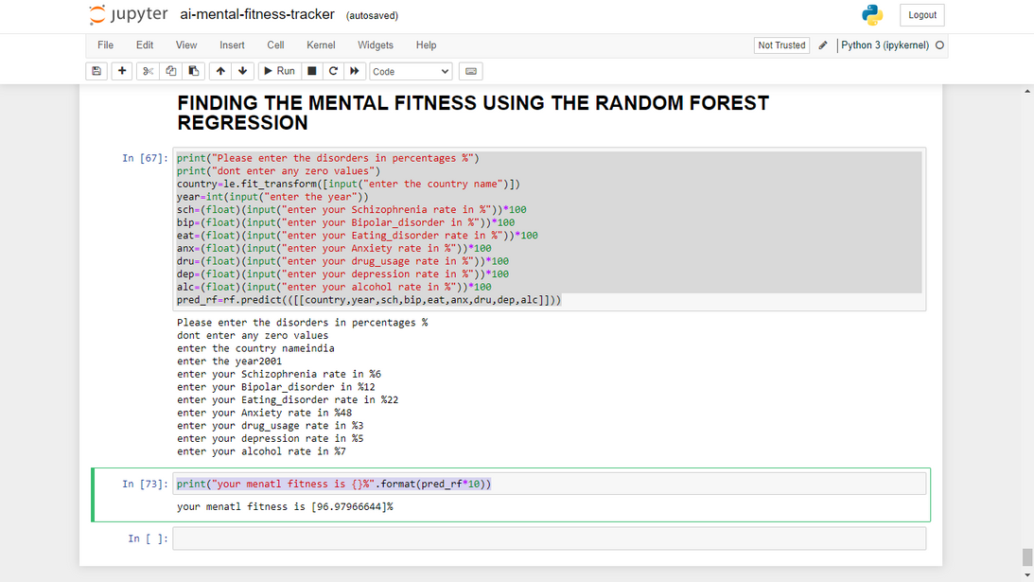

RESULTS

Slide 10



INTERNSHIP
ARTIFICIAL INTELLIGENCE
IBM SKILLSBUILD INTERNSHIP FOR EMERGING TECHNOLOGIES APR-MAY 2023
THANK YOU
MENTAL FITNESS TRACKING LINK : https://github.com/ranjithsurineni/mental_fitness_tracker_project.git
ranjithranji1903@gmail.com

